Slide 1
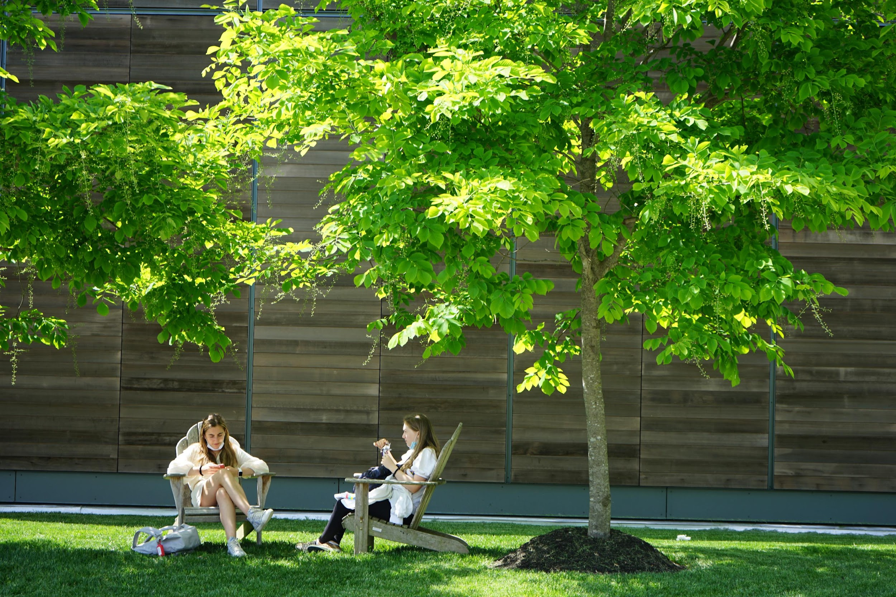
WELCOME to 8th GRADE!
Orientation
5/6/24

Slide 2
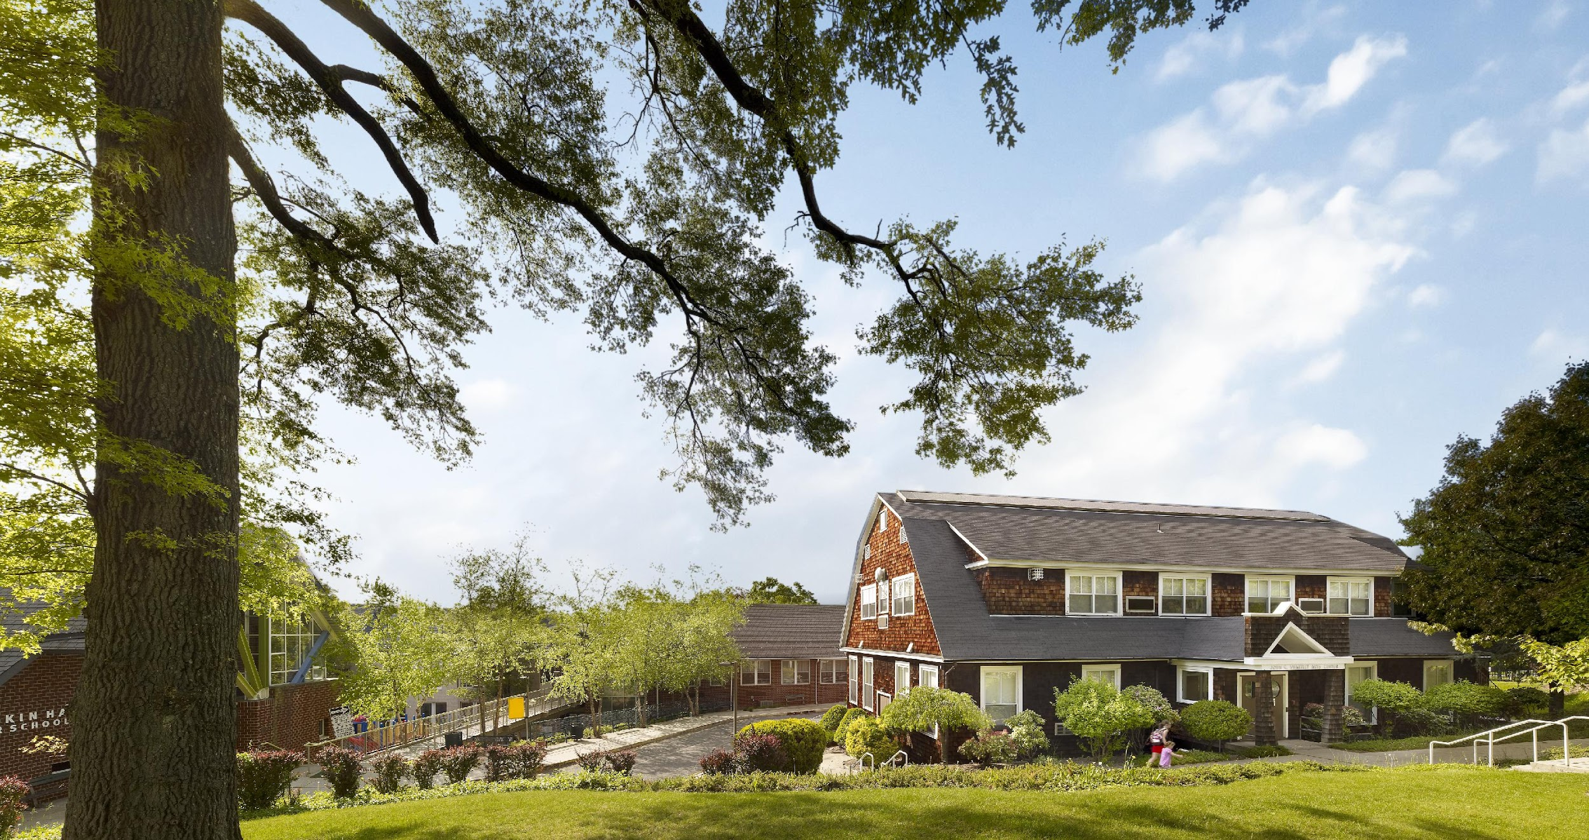
8th Grade Program
Academic program & instructions
Leadership Opportunities
Q & A
Tour of the 3rd Floor of MS building

Slide 3
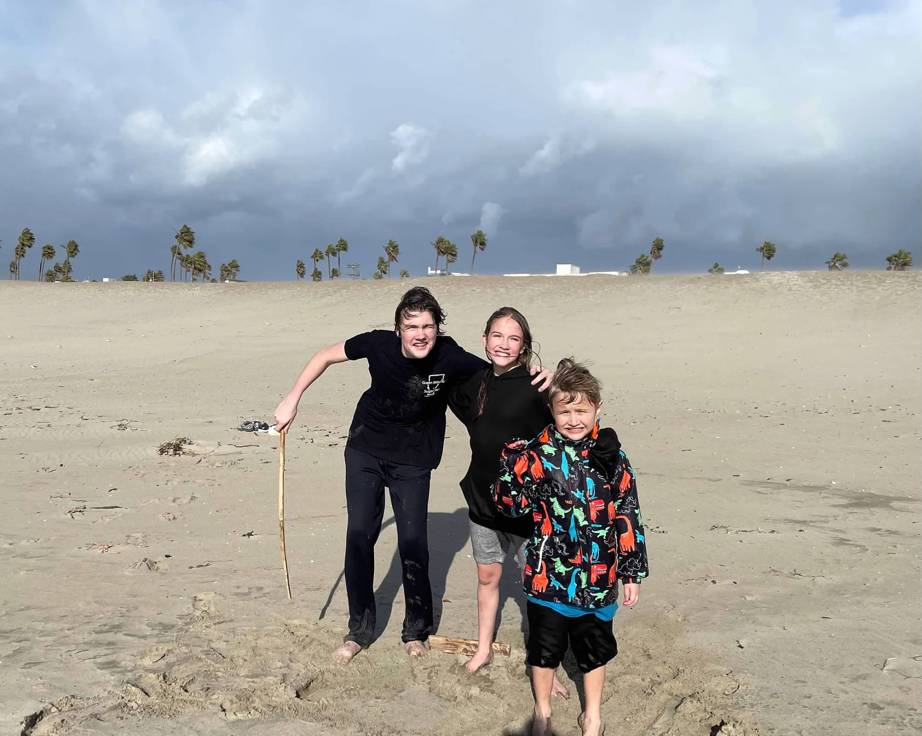
A little about me
Grew up in Park Ridge, NJ
Earned a B.A. in Drama from Ithaca College
Lived in Los Angeles for 25 years
Earned my Masters in Education from UCLA
Spent the majority of my career in Los Angeles at New Roads Middle School
Started there as a Humanities teacher and left as the Middle School Director
Returned to NJ three years ago
Taught 8th grade Humanities at Bank Street School for Children as a sabbatical leave replacement
And now at D-E!
I live with three children (15, 14 and 9), two rats, two guinea pigs, one dog and one leopard gecko.

Slide 4
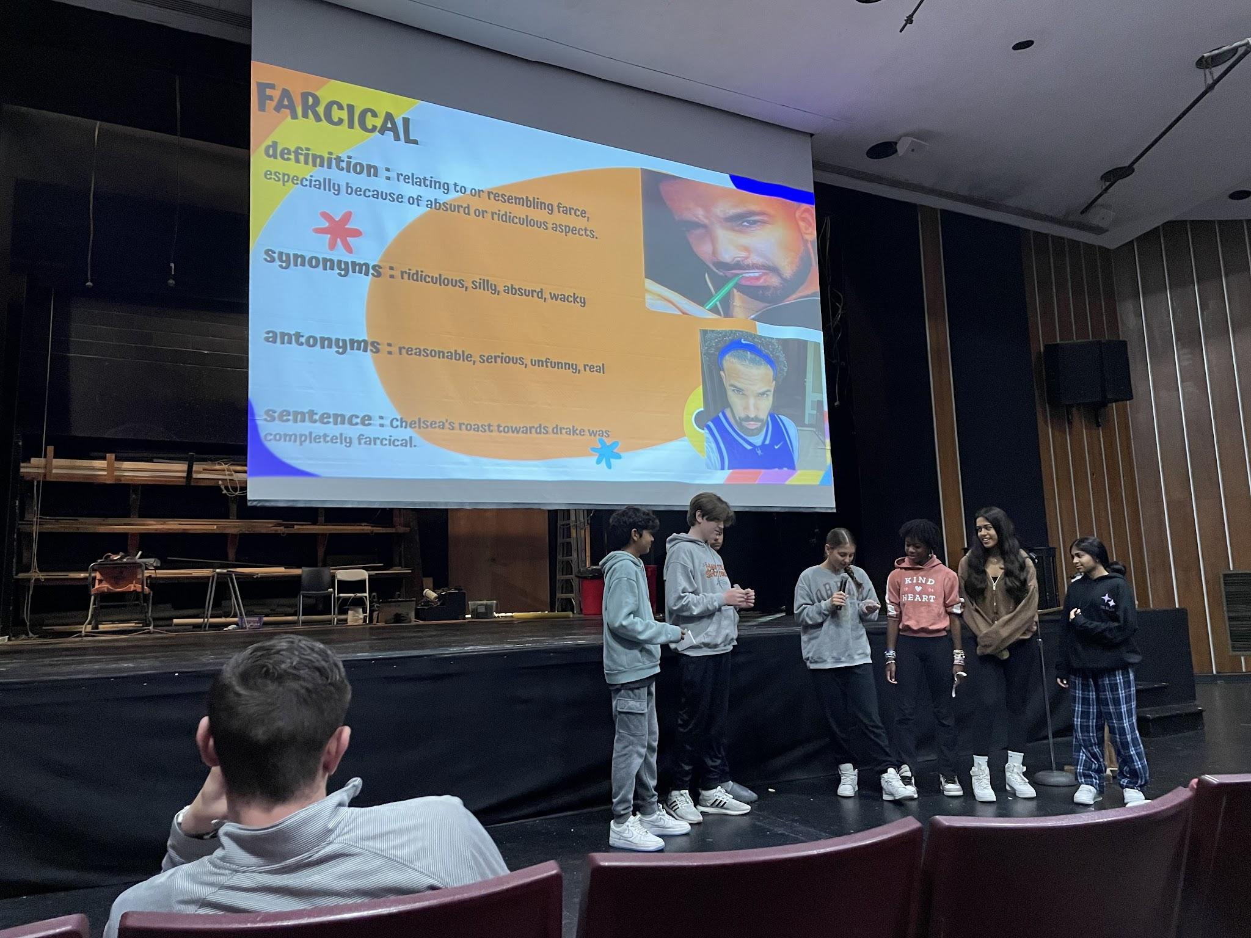
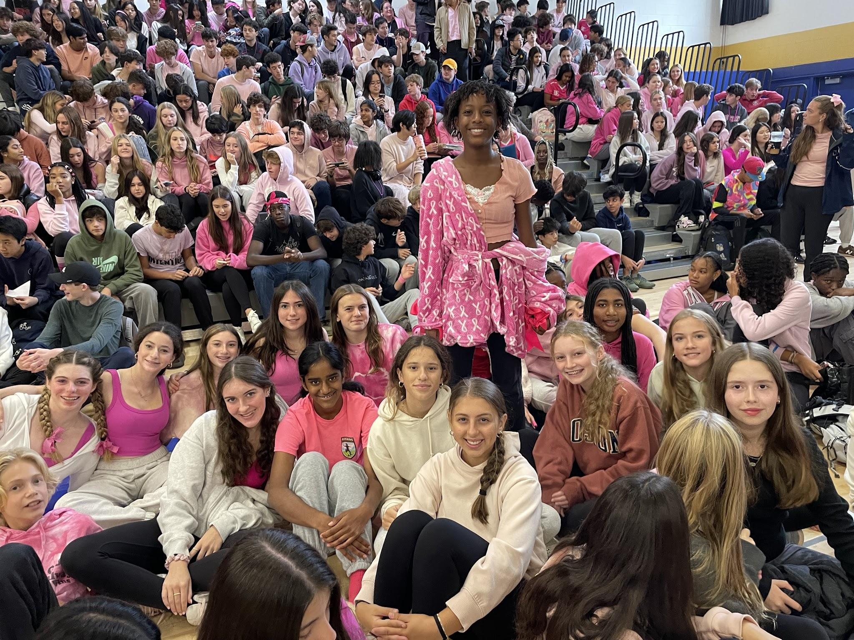
The last year of middle school…

Slide 5
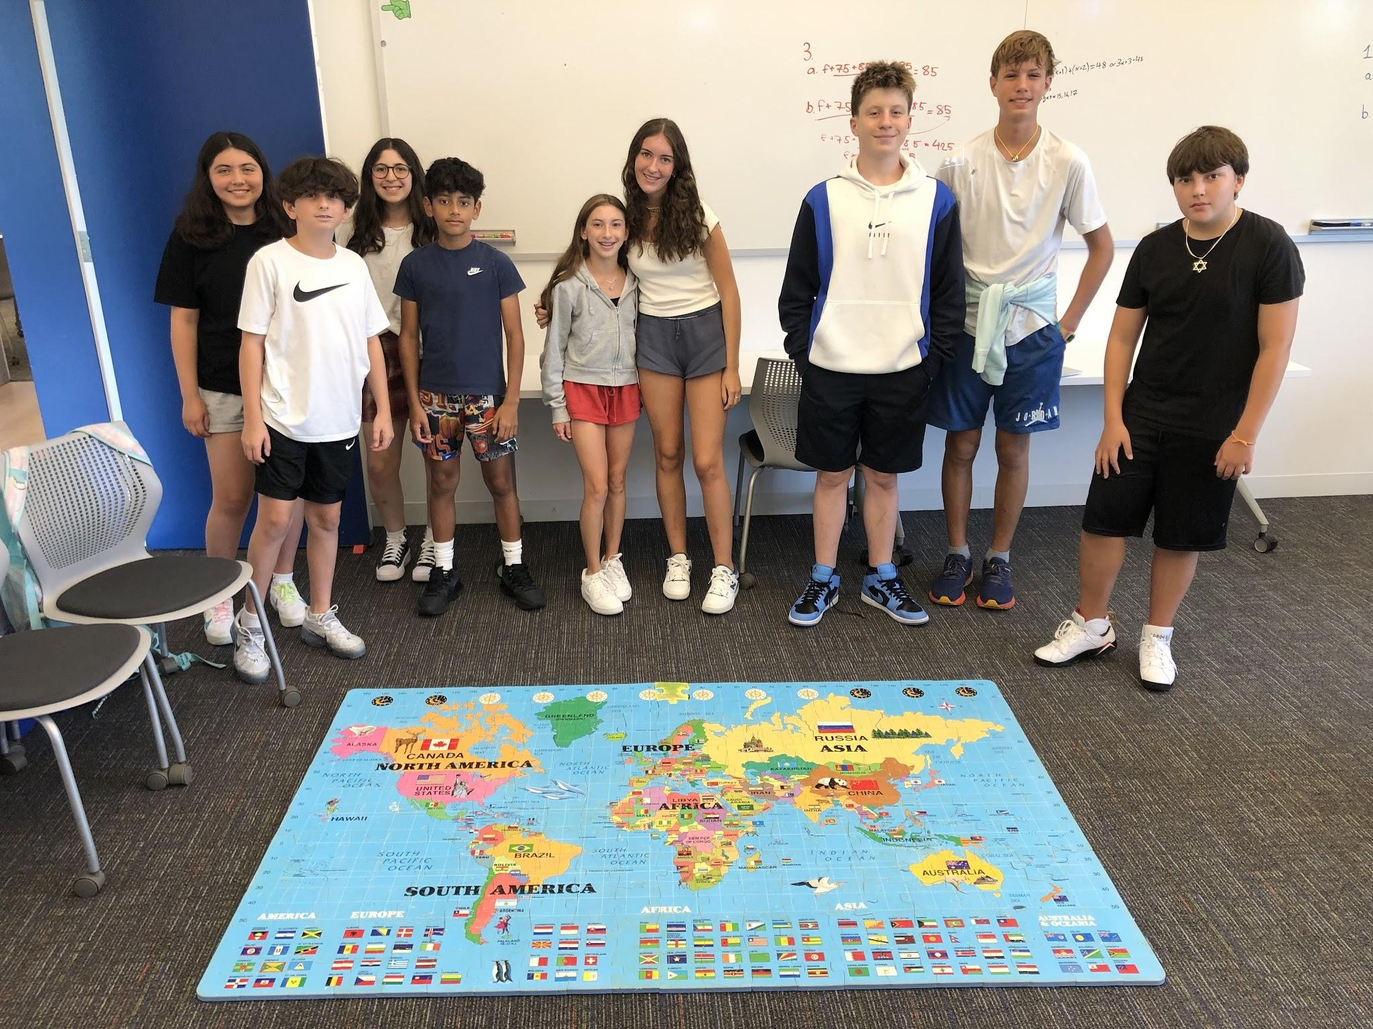
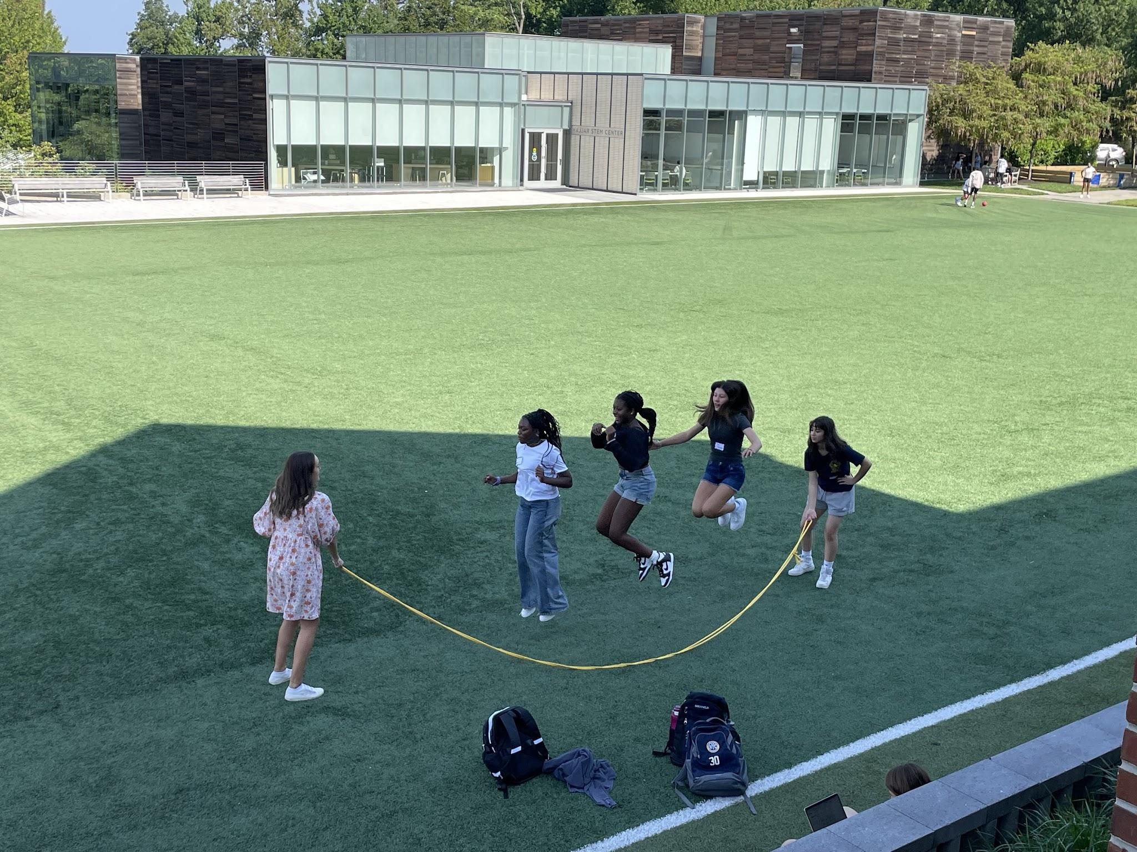
Advisory
A very important program for entire MS community;
We do a lot of our leadership
development & growth;
8-10 kids in each Advisory; Guided by a
Grade 8 teacher, your child’s
‘go-to’ adult on campus
Advisory creates bonds and serves a home base for students
If your child is new to D-E, they will be paired with a buddy
and they will be in the same advisory.

Slide 6
Leadership roles
1. We try to create many opportunities for Leadership in 8th grade
2. We encourage 8th graders to take on the challenges head on.
3. We encourage the concept of understanding how to use independence, and the maturity to know when to use it in different ways.
Notes:
We often expect 8th graders to be leaders, but they don’t necessarily have the tools in their toolbox to do so. We need to give them opportunities and coach them.

Slide 7
MESH Classes
Math
English
Science
History

Slide 8
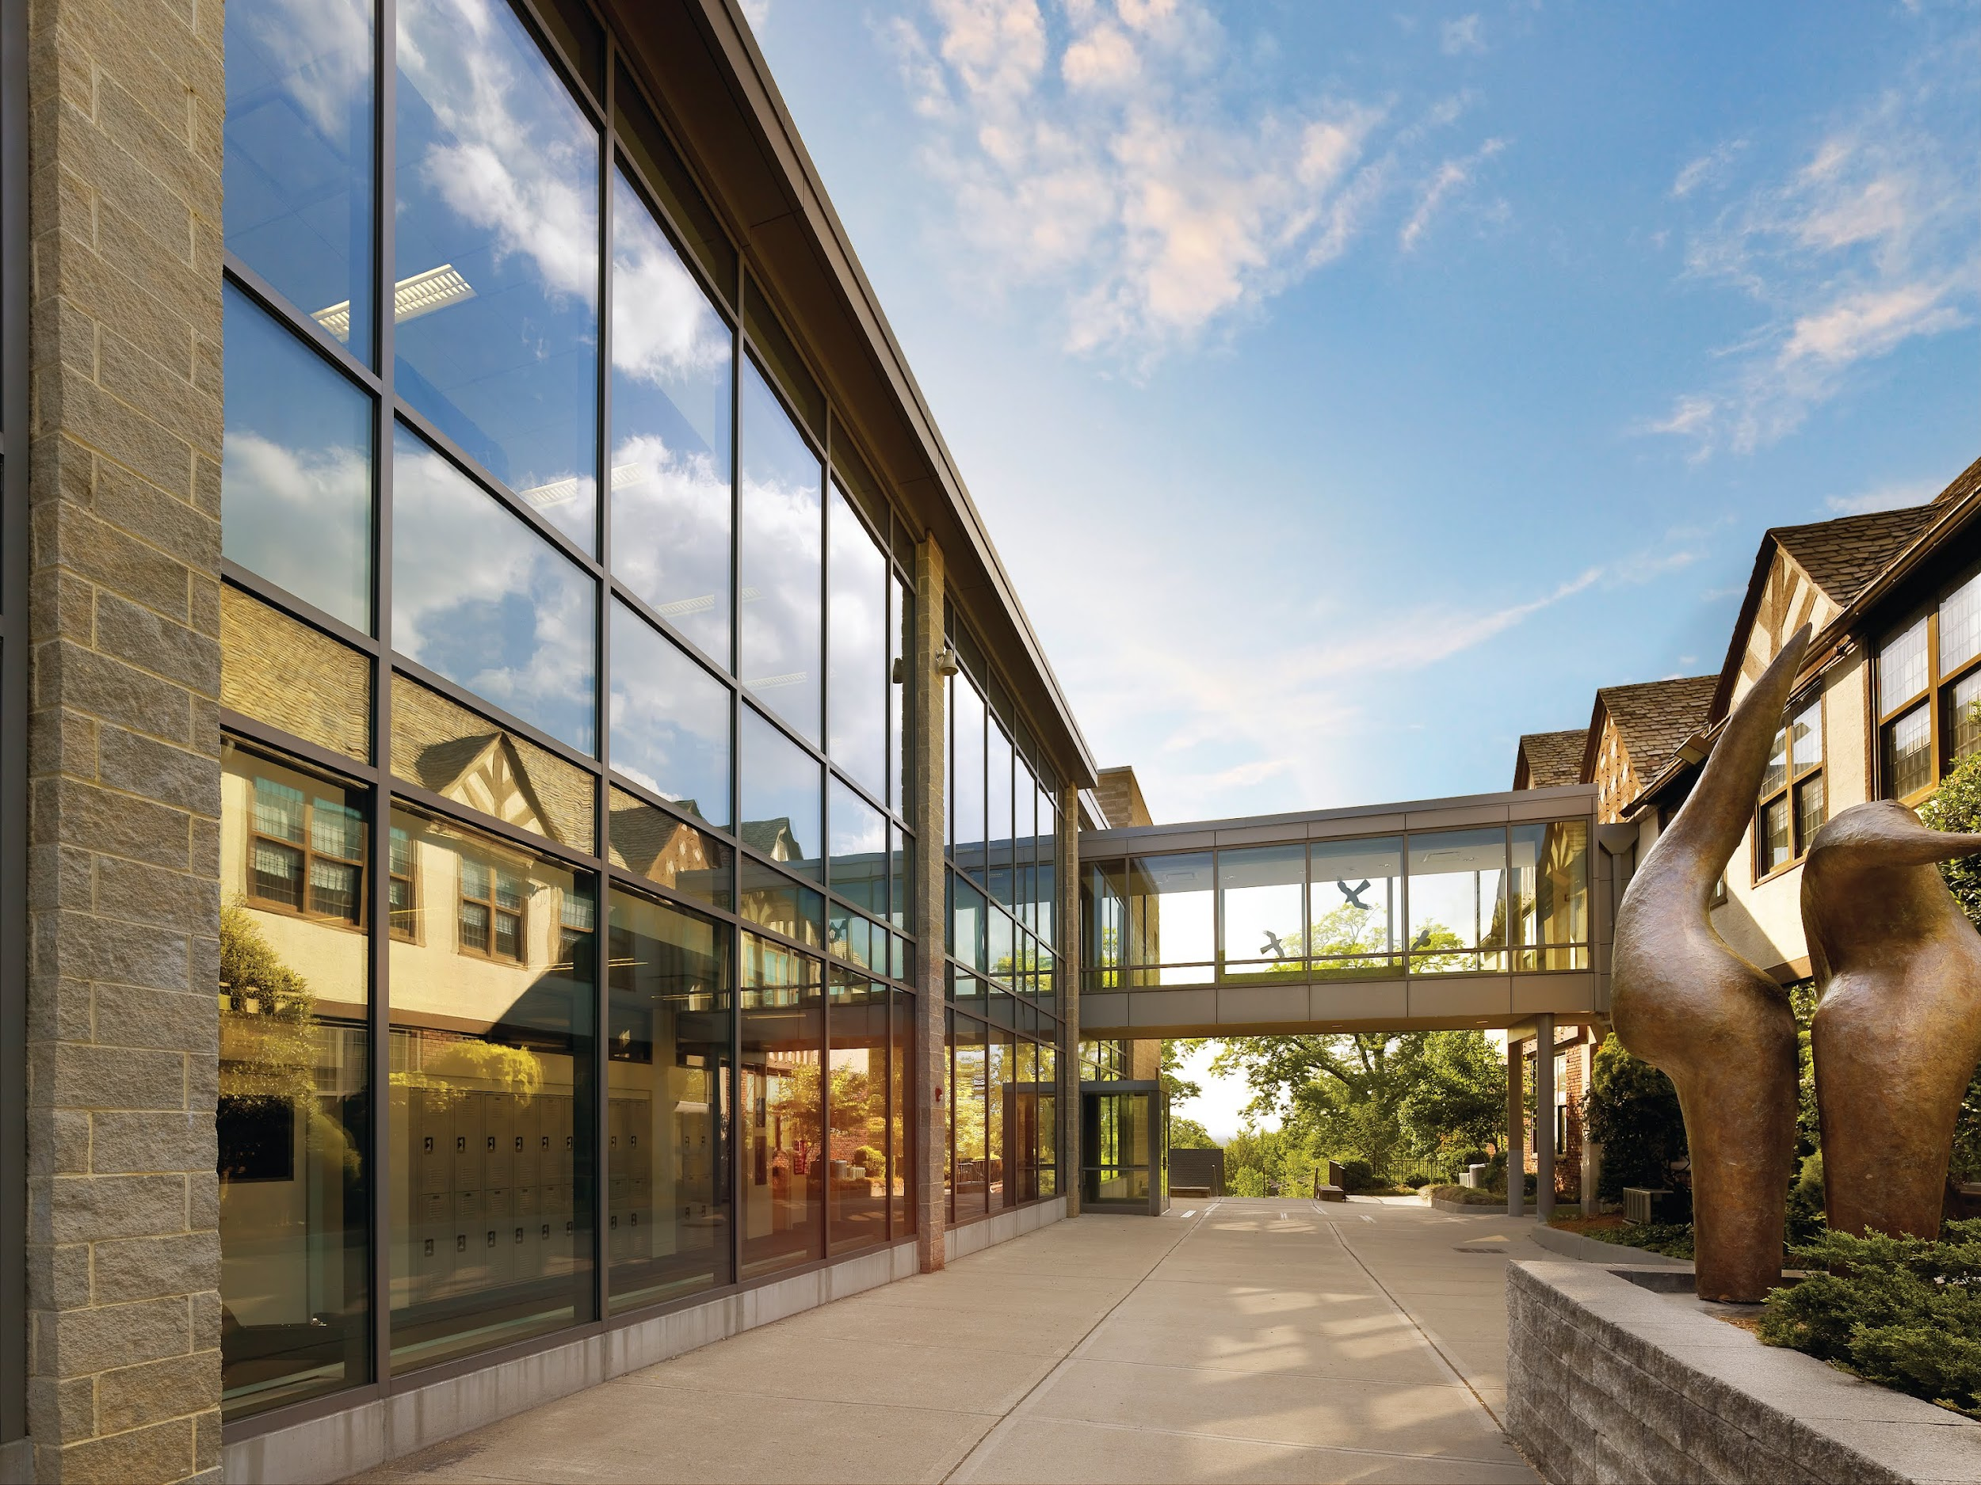
Physical Science
Themes
Questioning and analysis, as they begin to understand the role that energy plays in our daily activities, our society, the world, and our universe. Their curiosity about the physical and natural world is cultivated with a hands-on approach to science.
Skills
Students learn what is the best way to collect data and analyze their results. They also learn how to design an experiment and how to communicate and work with others.

Slide 9
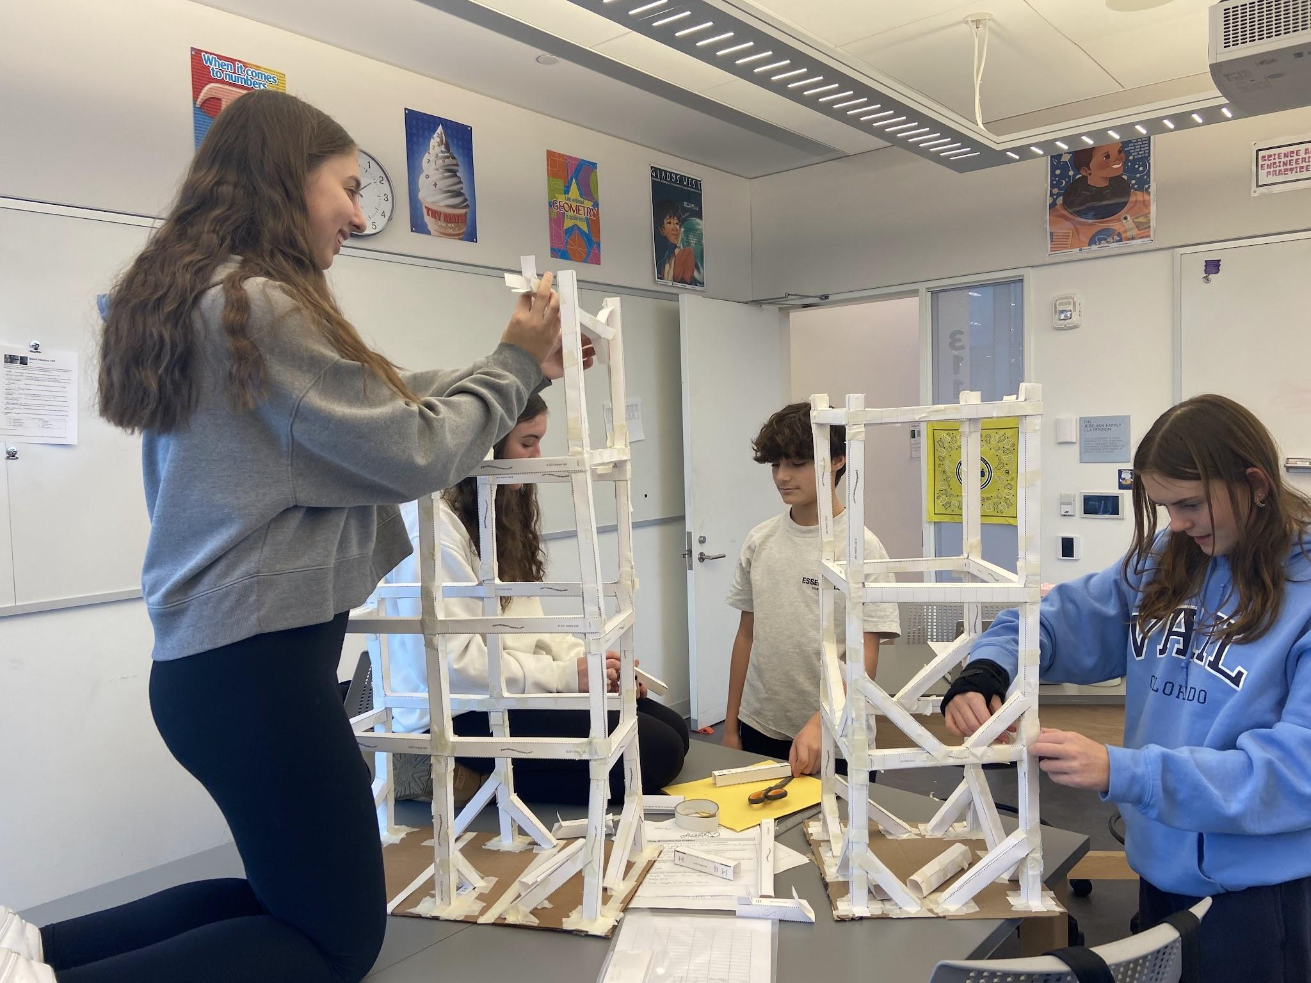
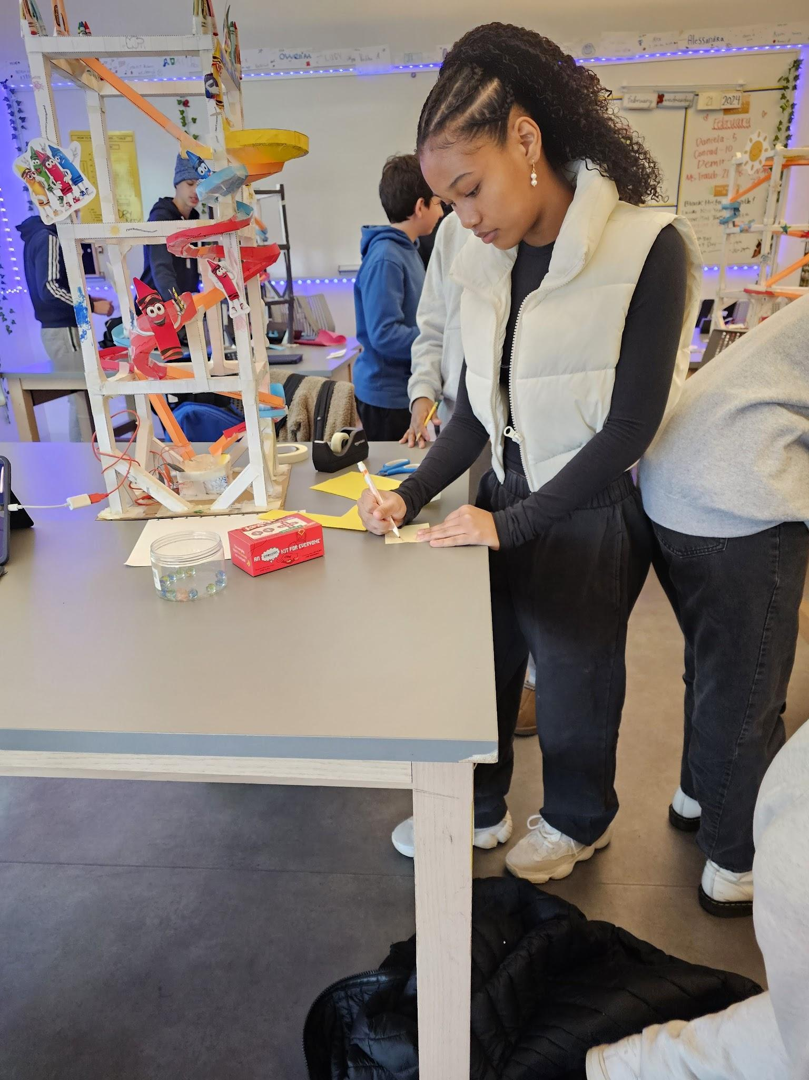
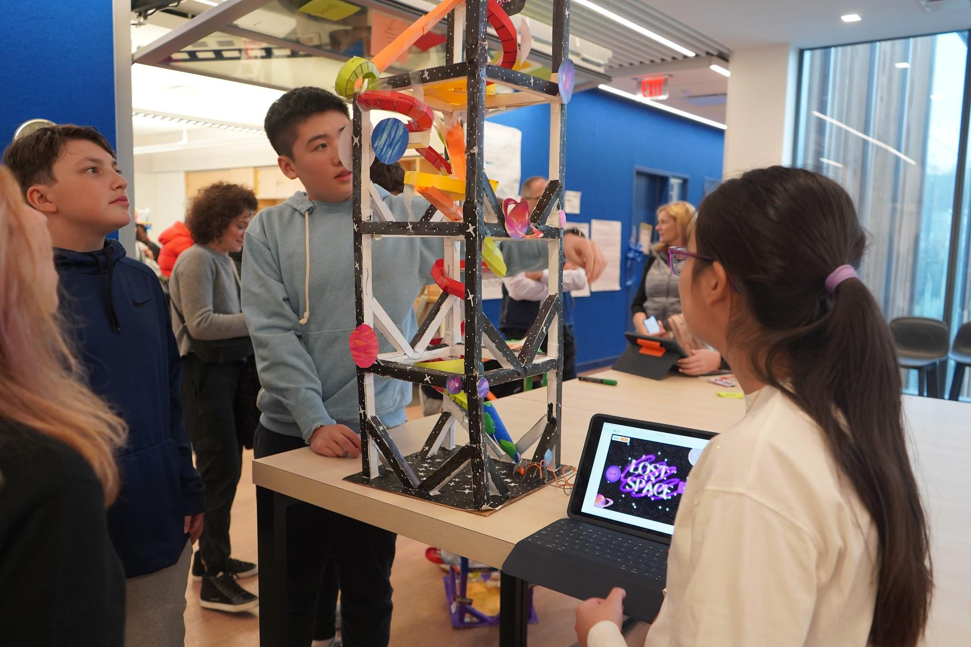
Roller Coaster Project
Physics-based project to apply the concepts of potential and kinetic energy
Iterative Design Process
Encourages creativity and collaboration
Final Presentation - Roller Coaster Expo

Slide 10
American Freedom (History)
Content
American Revolution, the Civil War, the Civil Rights Movement, and
Current Events.
Themes
Understanding & applying perspective, cause and effect and interconnection;
Beliefs and individuality; and
Civic Choices, individual and collective argument and opposition.
Skills
Developing and defending an argument, use of evidence in writing, reading, public speaking and use of primary source documents.

Slide 11
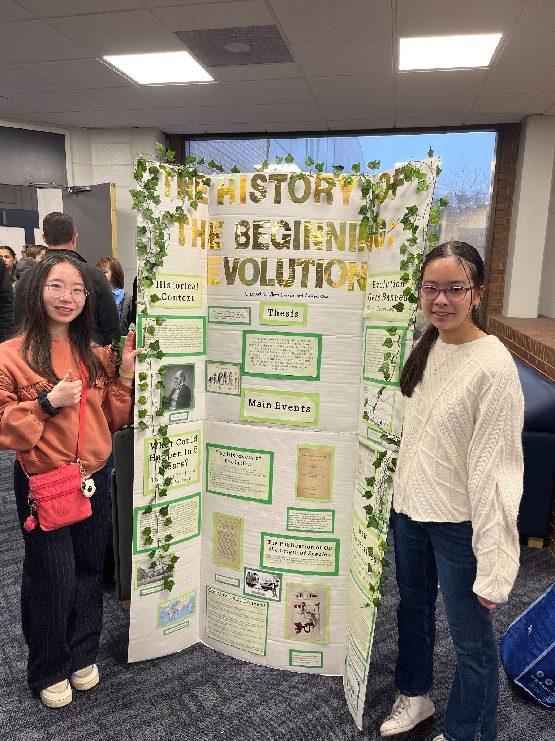
National History Day
All students in the 8th grade do this project.
Students get to choose both their topic and their presentation: presentation board, essay, website, performance, documentary.
This year’s theme was Turning Points in History.
Some students chose to compete at the regional level. Students who placed at that level then went on to present their project at the state level on May 4.
Notes:
Title IX, Walt Disney, Nintendo, the Triangle Shirtwaist Factory Fire, the Me Too movement, commercial airline travel

Slide 12
Math
Content: Algebra, Geometry
Three Levels: College Prep Advanced “Hyper”
Themes
Interactive problem solving
Skills
Equations, graphing, polynomials;
Focus on Comfort and Application;
Desmo (App on Ipad)
Understanding skill, not memorization; and
Explaining / communicating through writing the ‘solution process’.

Slide 13
The Courage of Our Conviction (English)
Content
Just Mercy, Fahrenheit 451, The House on Mango Street & Romeo and Juliet.
Themes
Standing up for one’s beliefs
Persuasive speech,
Forming, defending conviction,
Courage
Skills
Public Speaking,
Writing, Research,
Reading,
Portfolio development

Slide 14
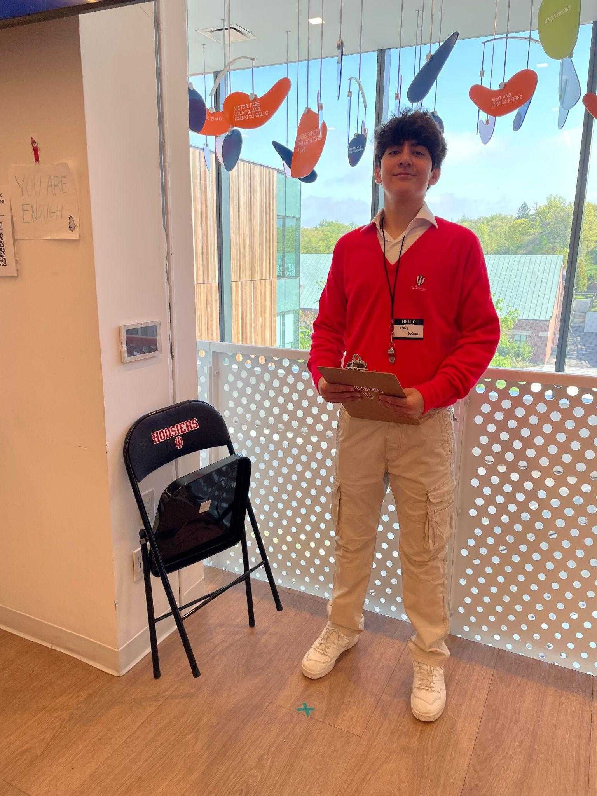
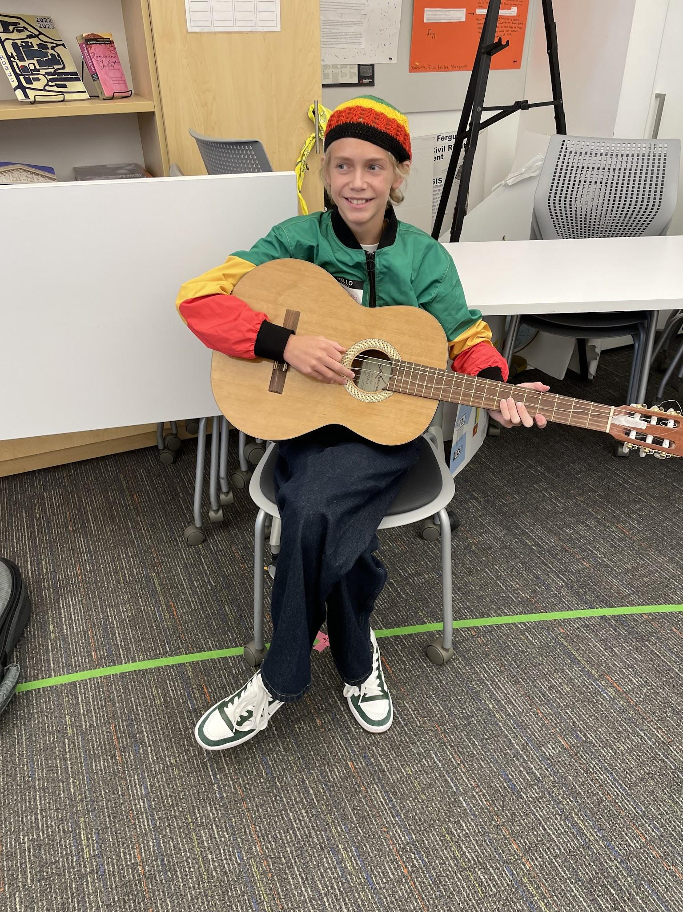
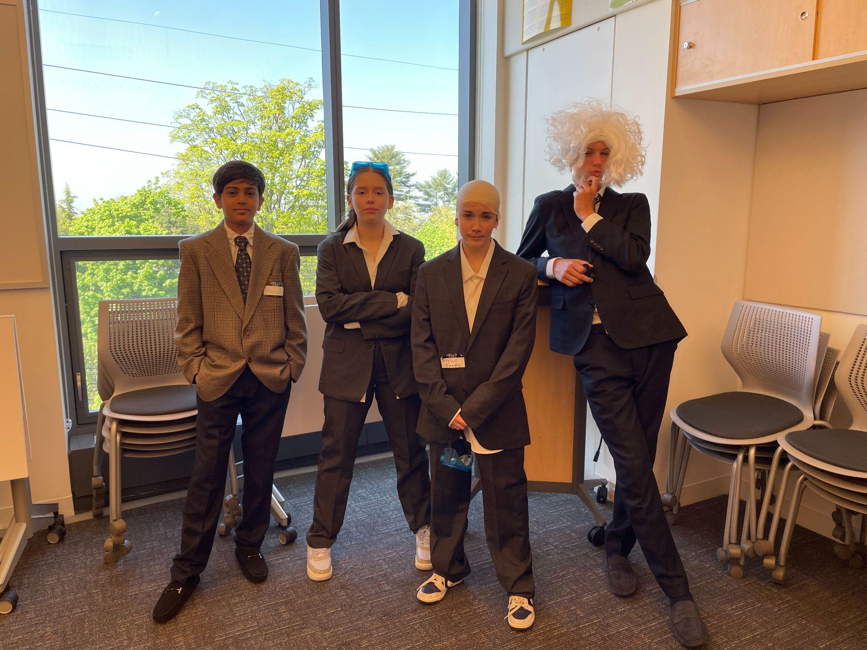
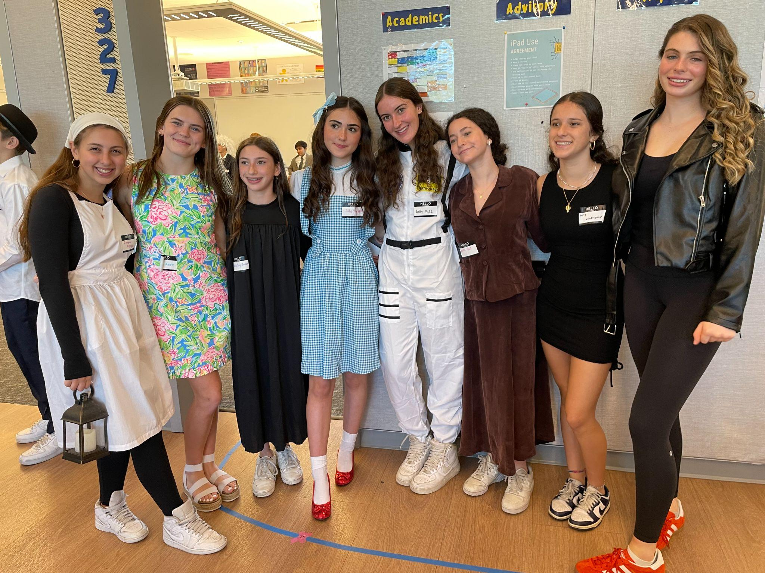
Living Wax Museum
Notes:
Once again, students have choice as they get to choose the person to research, write about and perform as (with teacher approval).

Slide 15
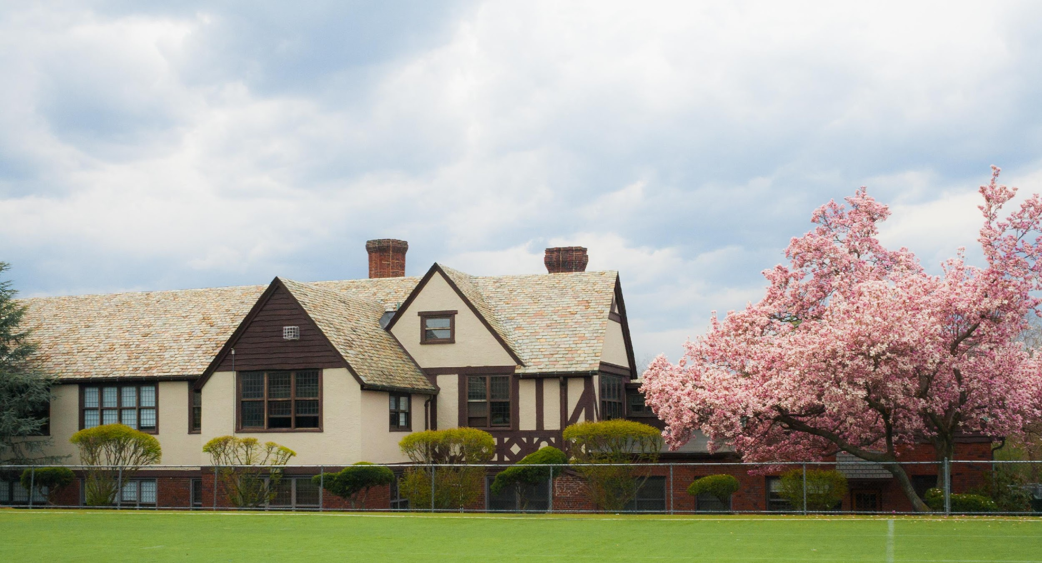
Grade 8 Program Components
Advisory 3, 20-minute meetings per week
(Core program to the MS, committee plans programming)
Community Meetings (Morning Meeting) & (Assembly) 2 meetings per week
MESH Classes 16 – 18 periods per week
English, Social Studies, Math, Science
Languages (1 required, 2nd available) 4 periods per week
French 8, French 8 Advanced (varies by year), Spanish 8, Spanish 8 Advanced, Latin 8, Latin 8 Advanced
Activities 2 periods per week
(Interscholastic athletics team practices and play rehearsals are mostly after school,
but begin during activity periods on the days that activities meet.)
Music (optional) 2 periods per week
Orchestra & Chorus
(Students who do not enroll in music will take another two TAGs)
Arts 3 periods per week/1 semester
Music
Drama
Health & Wellness 3 periods per week
Electives (one of the following) 3 periods a week
2nd language
Discovery Class

Slide 16
ELECTIVE
Electives
A. 2nd language: Spanish, Latin or French
OR
B. Discovery Classes:
Art & Design Sequential Art
Art & Design Explorations
Traditional West African Drumming, Singing & Dancing
Show Choir- Interested eager singers
D.I.G. (Dwight in the Garden) -Maintain and learn how to operate a garden on campus
Physical Computing -Coding, software writing.
In the News
Rhythm and Grooves Workshop
Theater Tech and Stagecraft
Descriptions will be on the resources page you will get.
OR
C. ASK 8 – recommended by the school- Mr. Aitken will contact you if this applies

Slide 17
Seek Trips
A significant start to the 8th grade year
SEEK trips actually offer opportunity for Leadership
Each trip has 20/25 kids
We encourage them to go on a trip that might be new, engaging, fun and learn new things.
Students on the SEEK committee are researching options.
Previous locations have included:
Washington, D.C.
Boston, MA
Burlington, VT
Montreal, Canada
Lake Placid
Cape Cod
Portland, ME

Slide 18
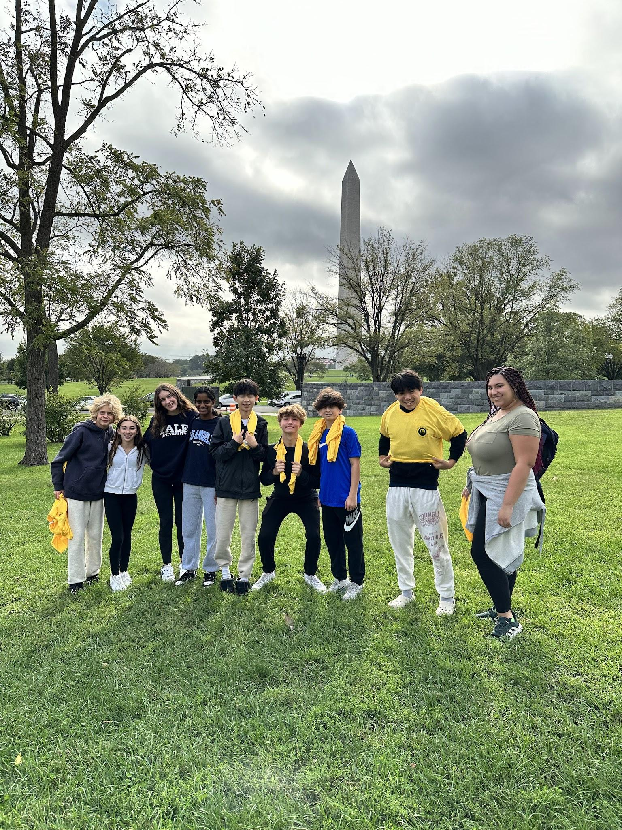
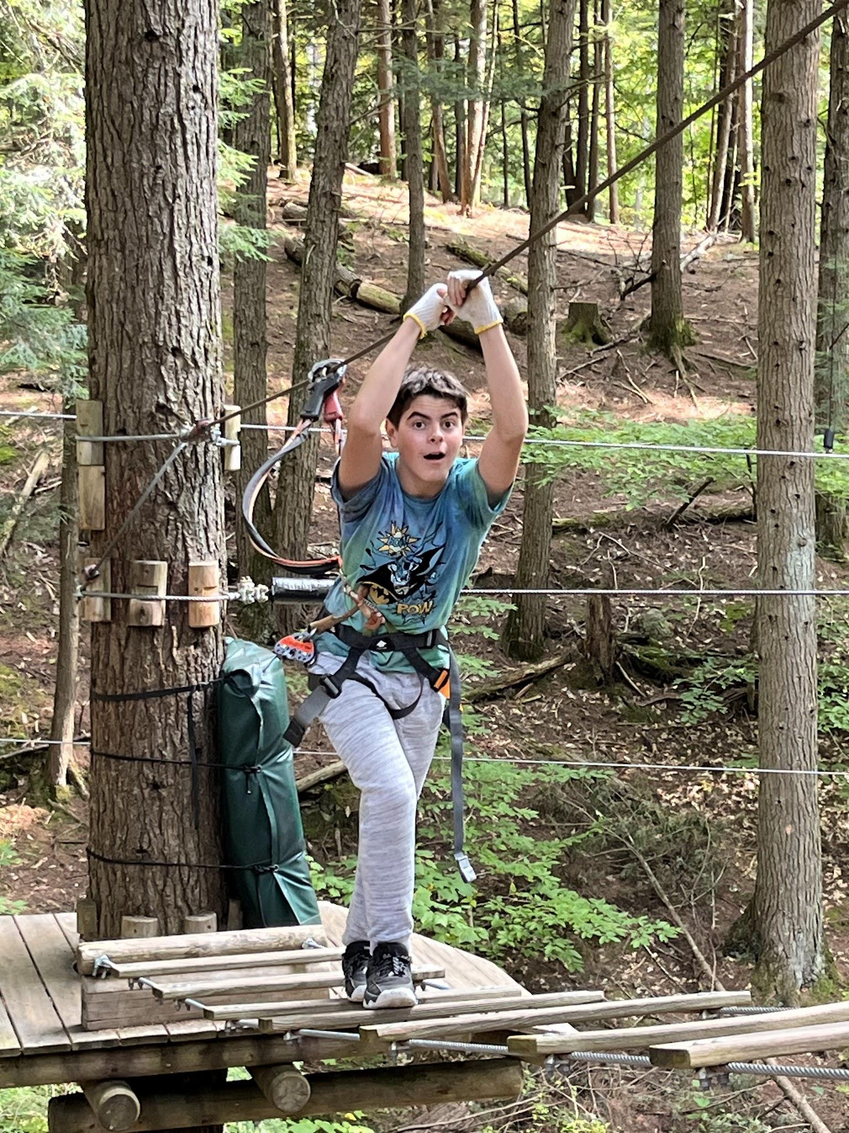
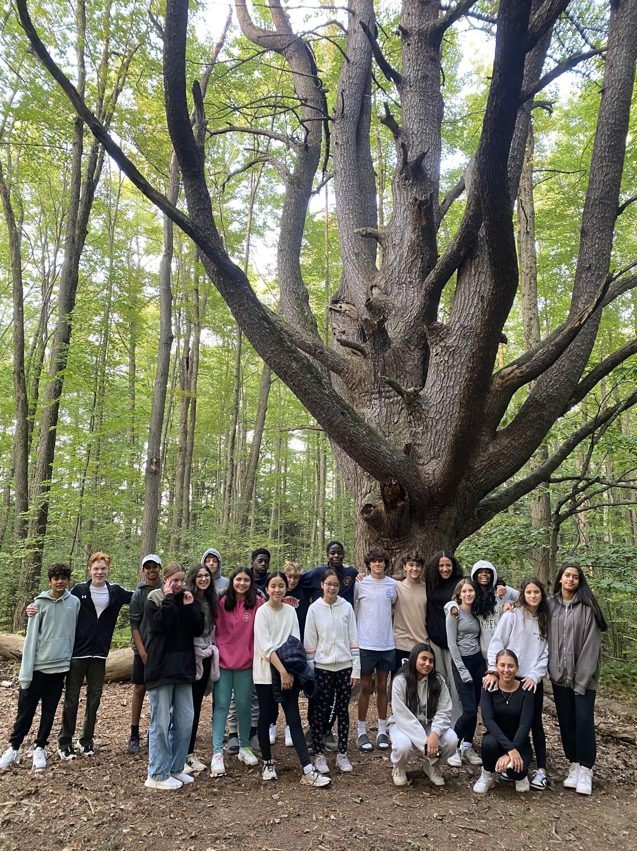
Seek Trips
Notes:
All Seek trips have: ropes course, service activity, social activity (bowling, arcade, etc.)

Slide 19
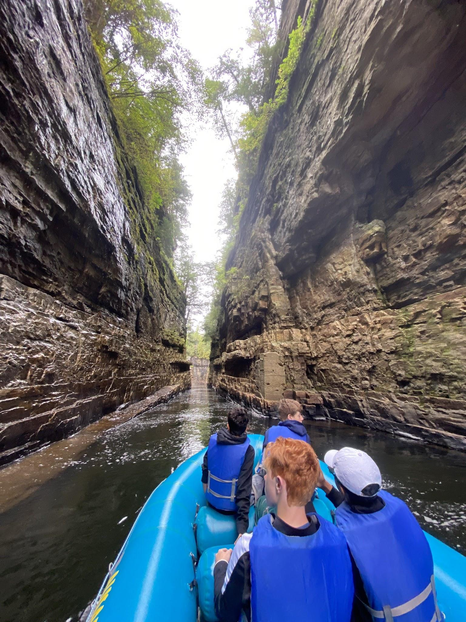
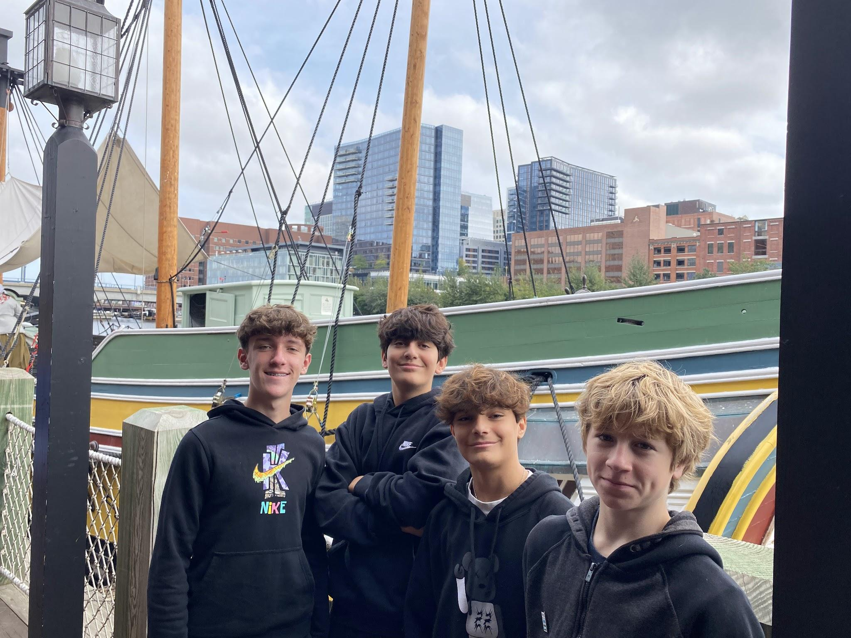
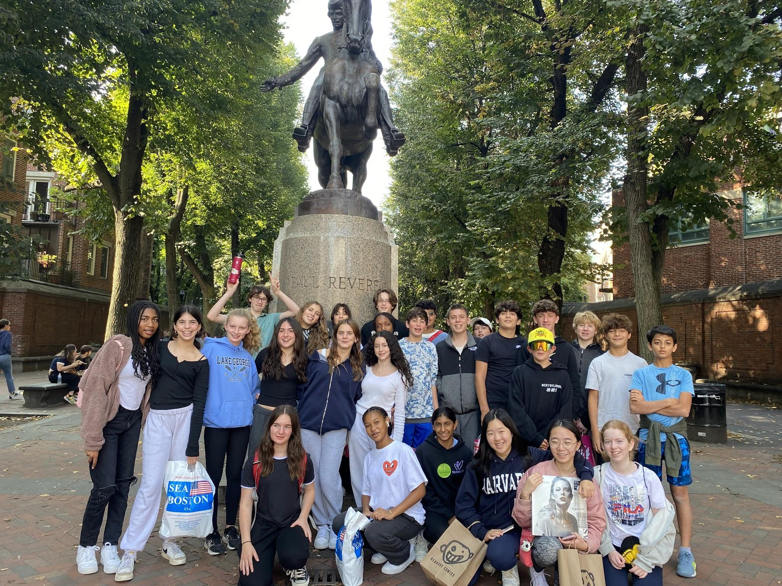
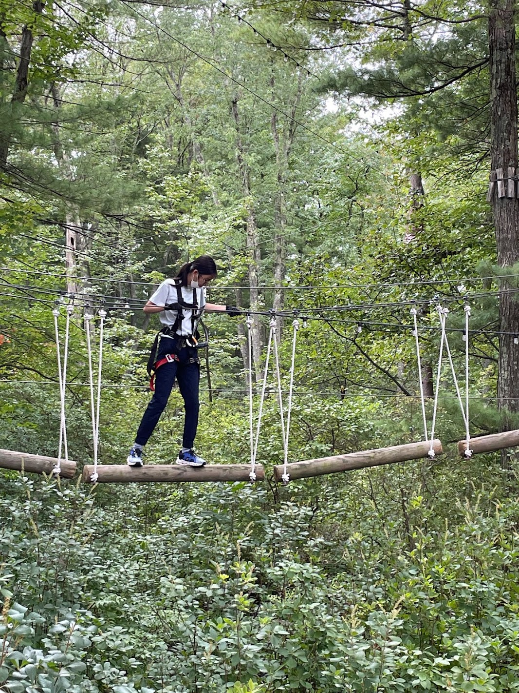
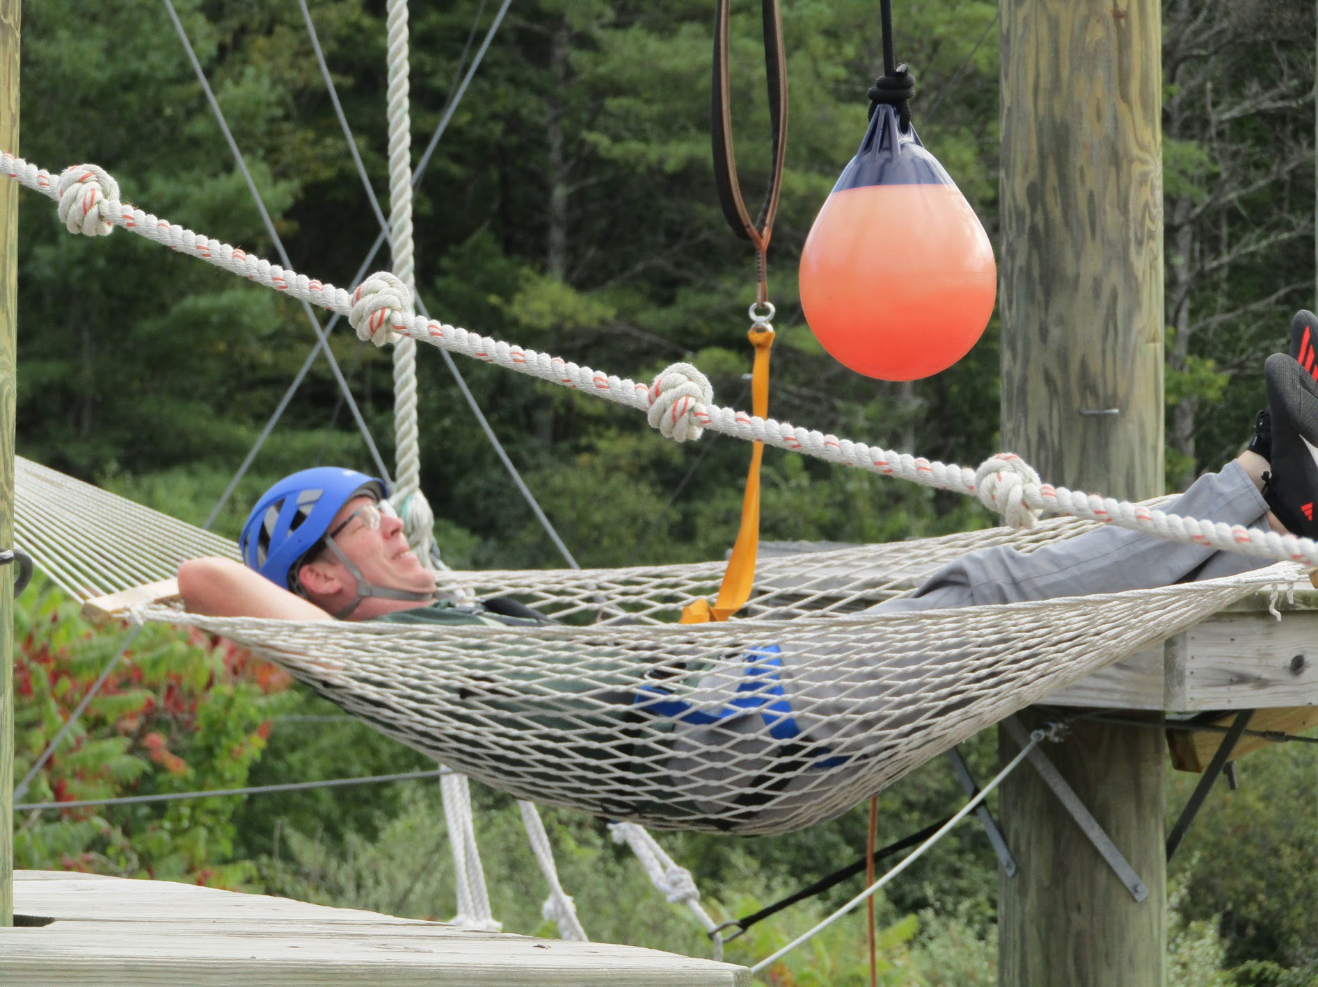
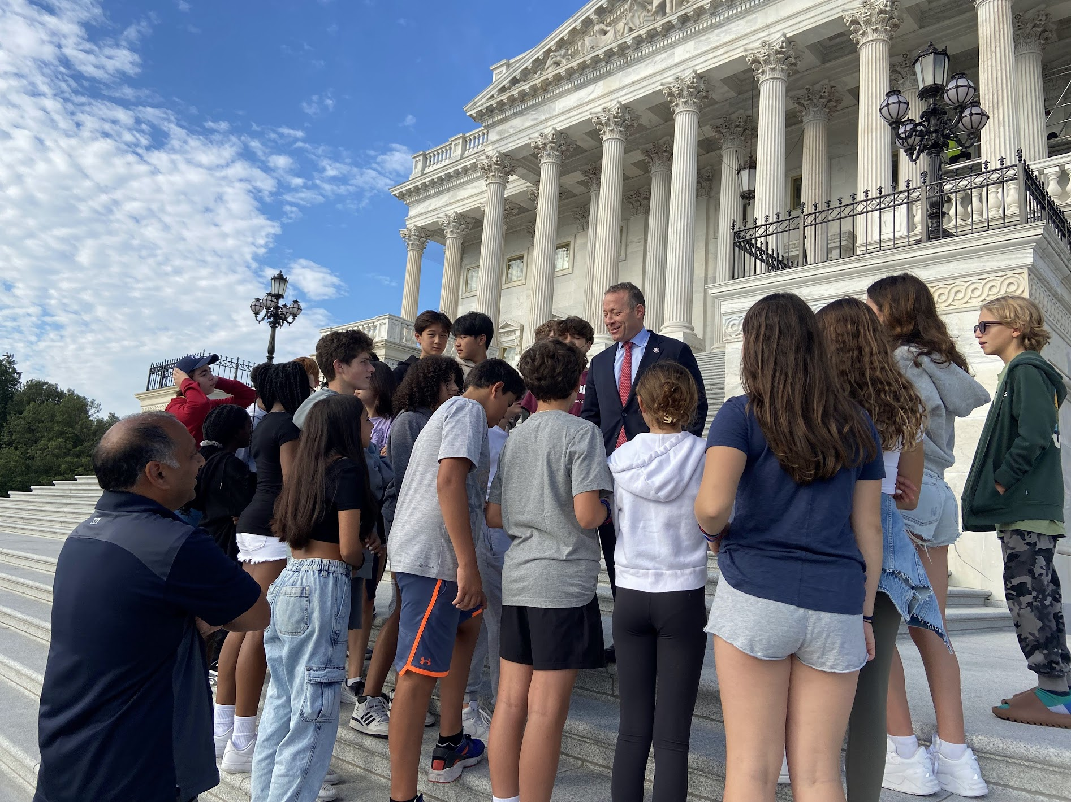

Slide 20
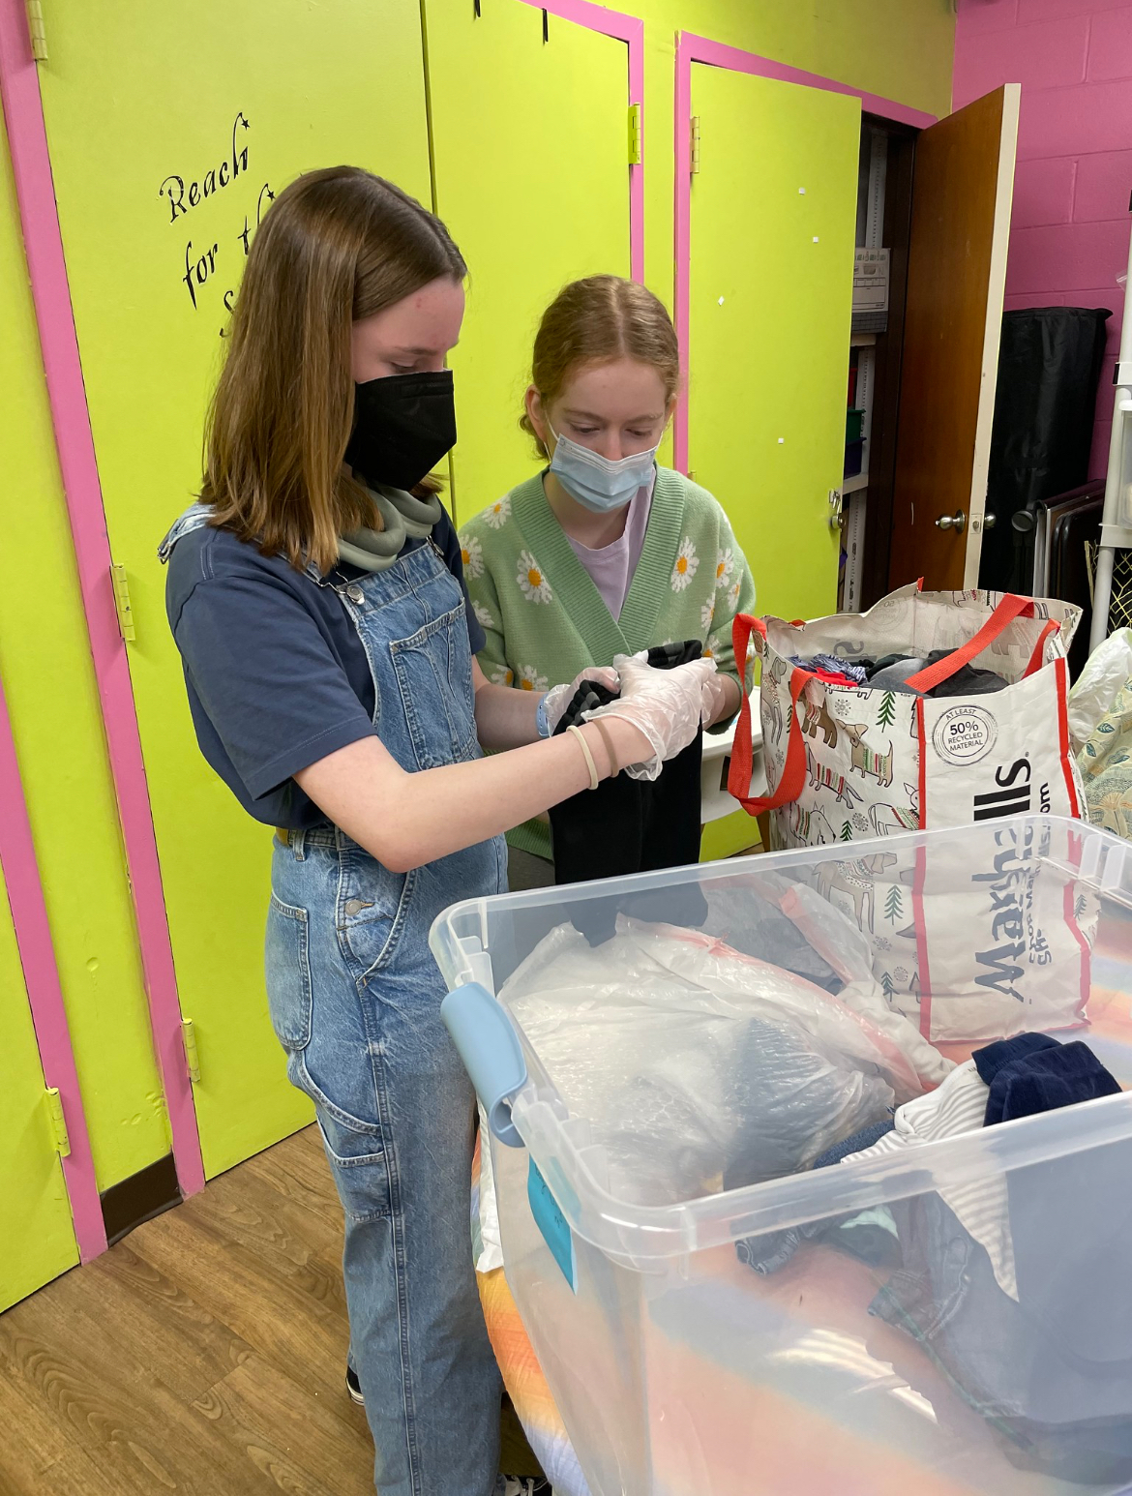
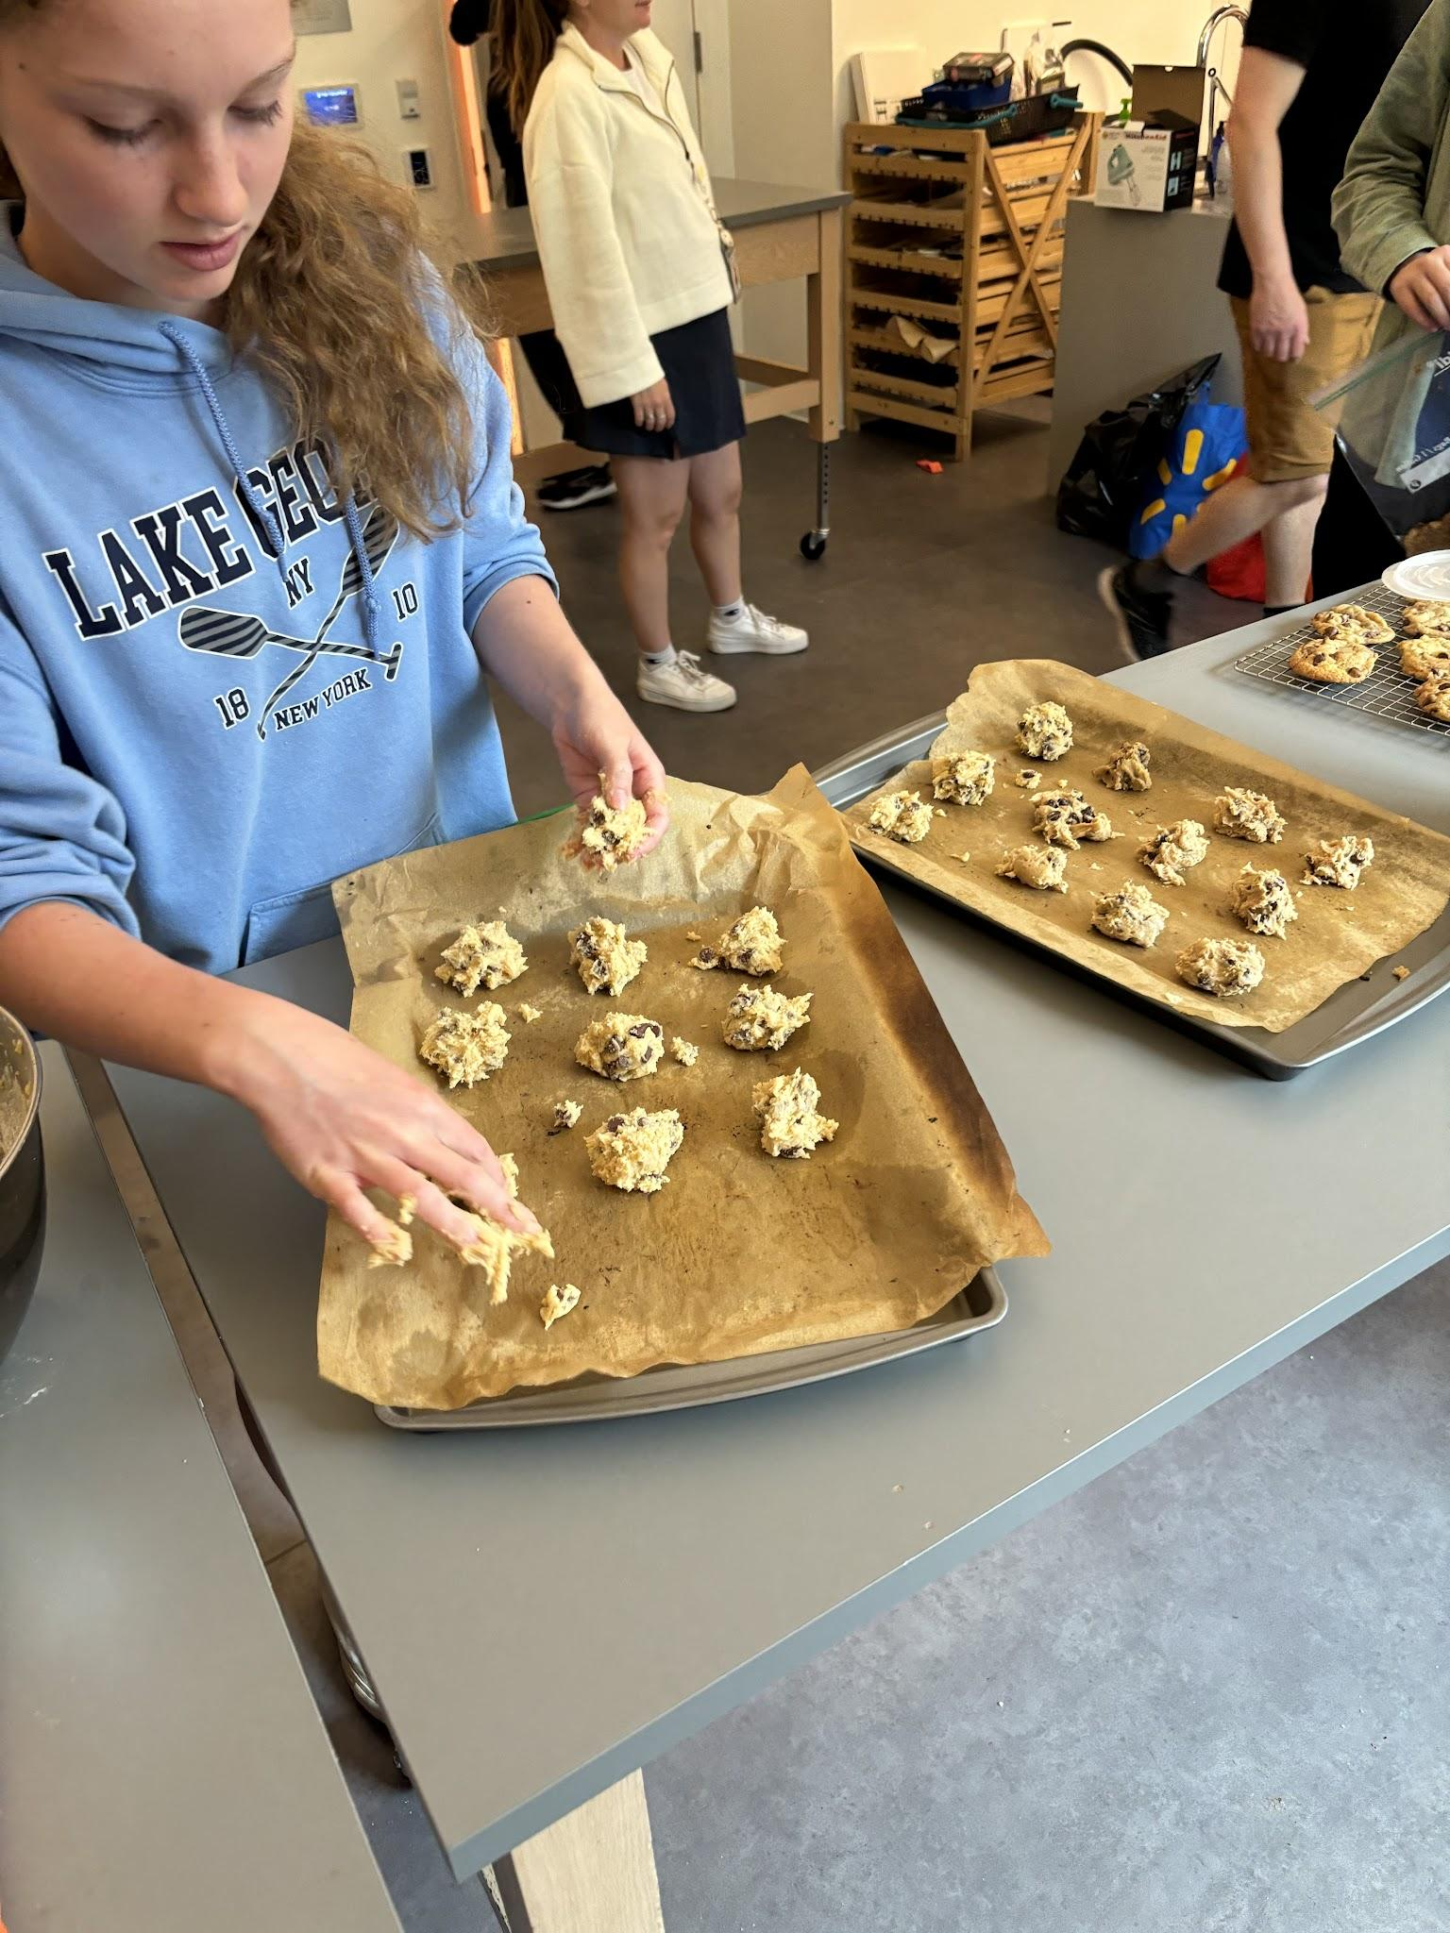
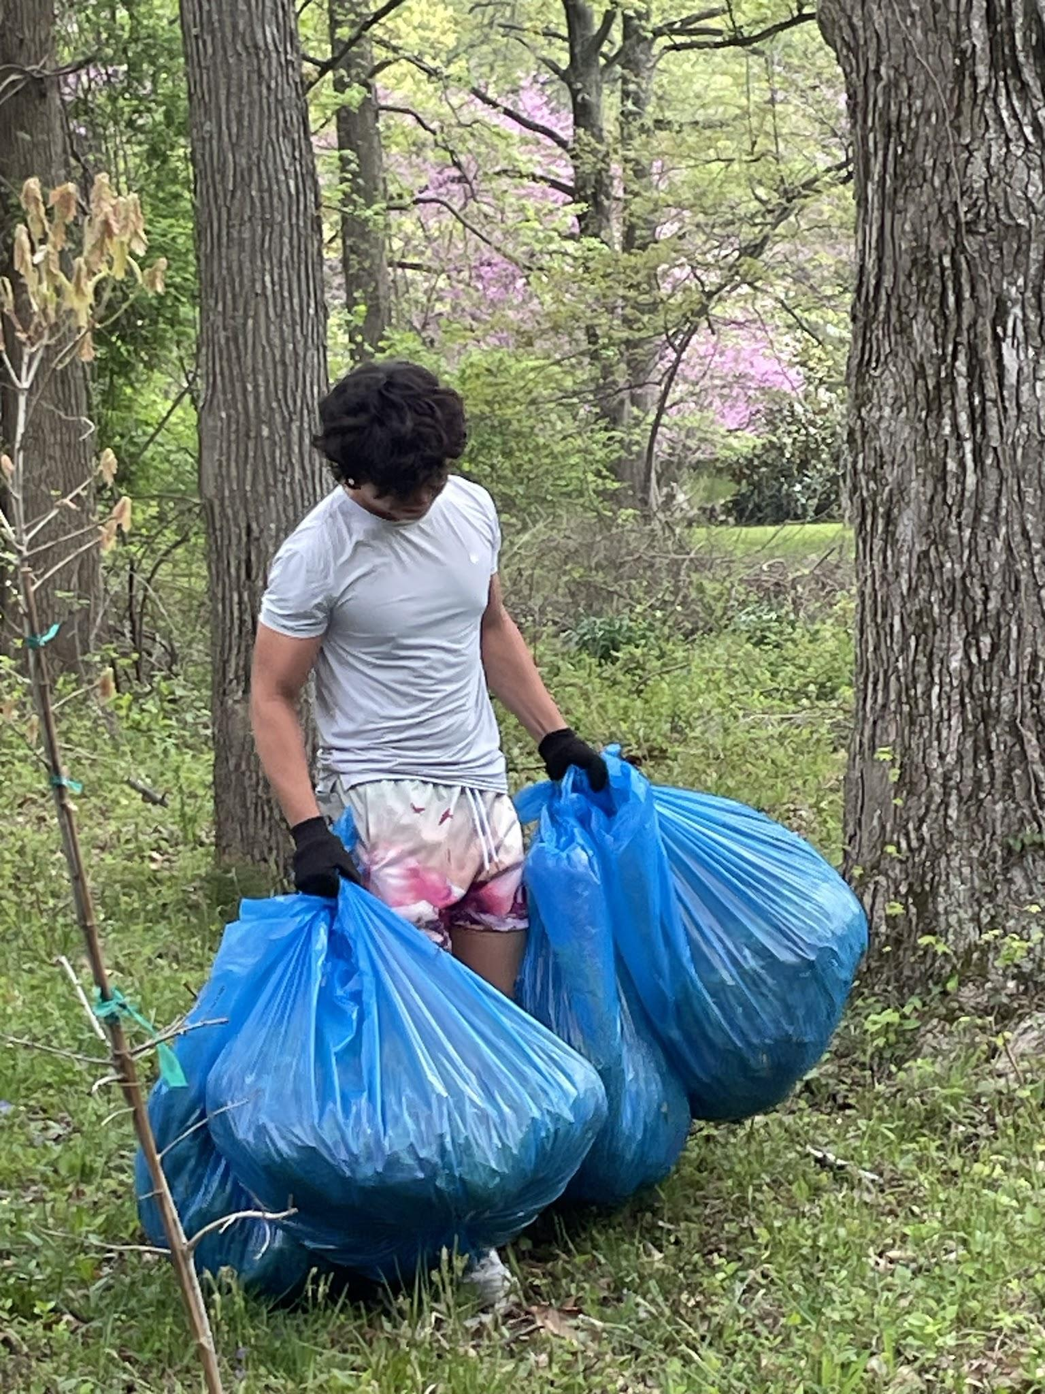
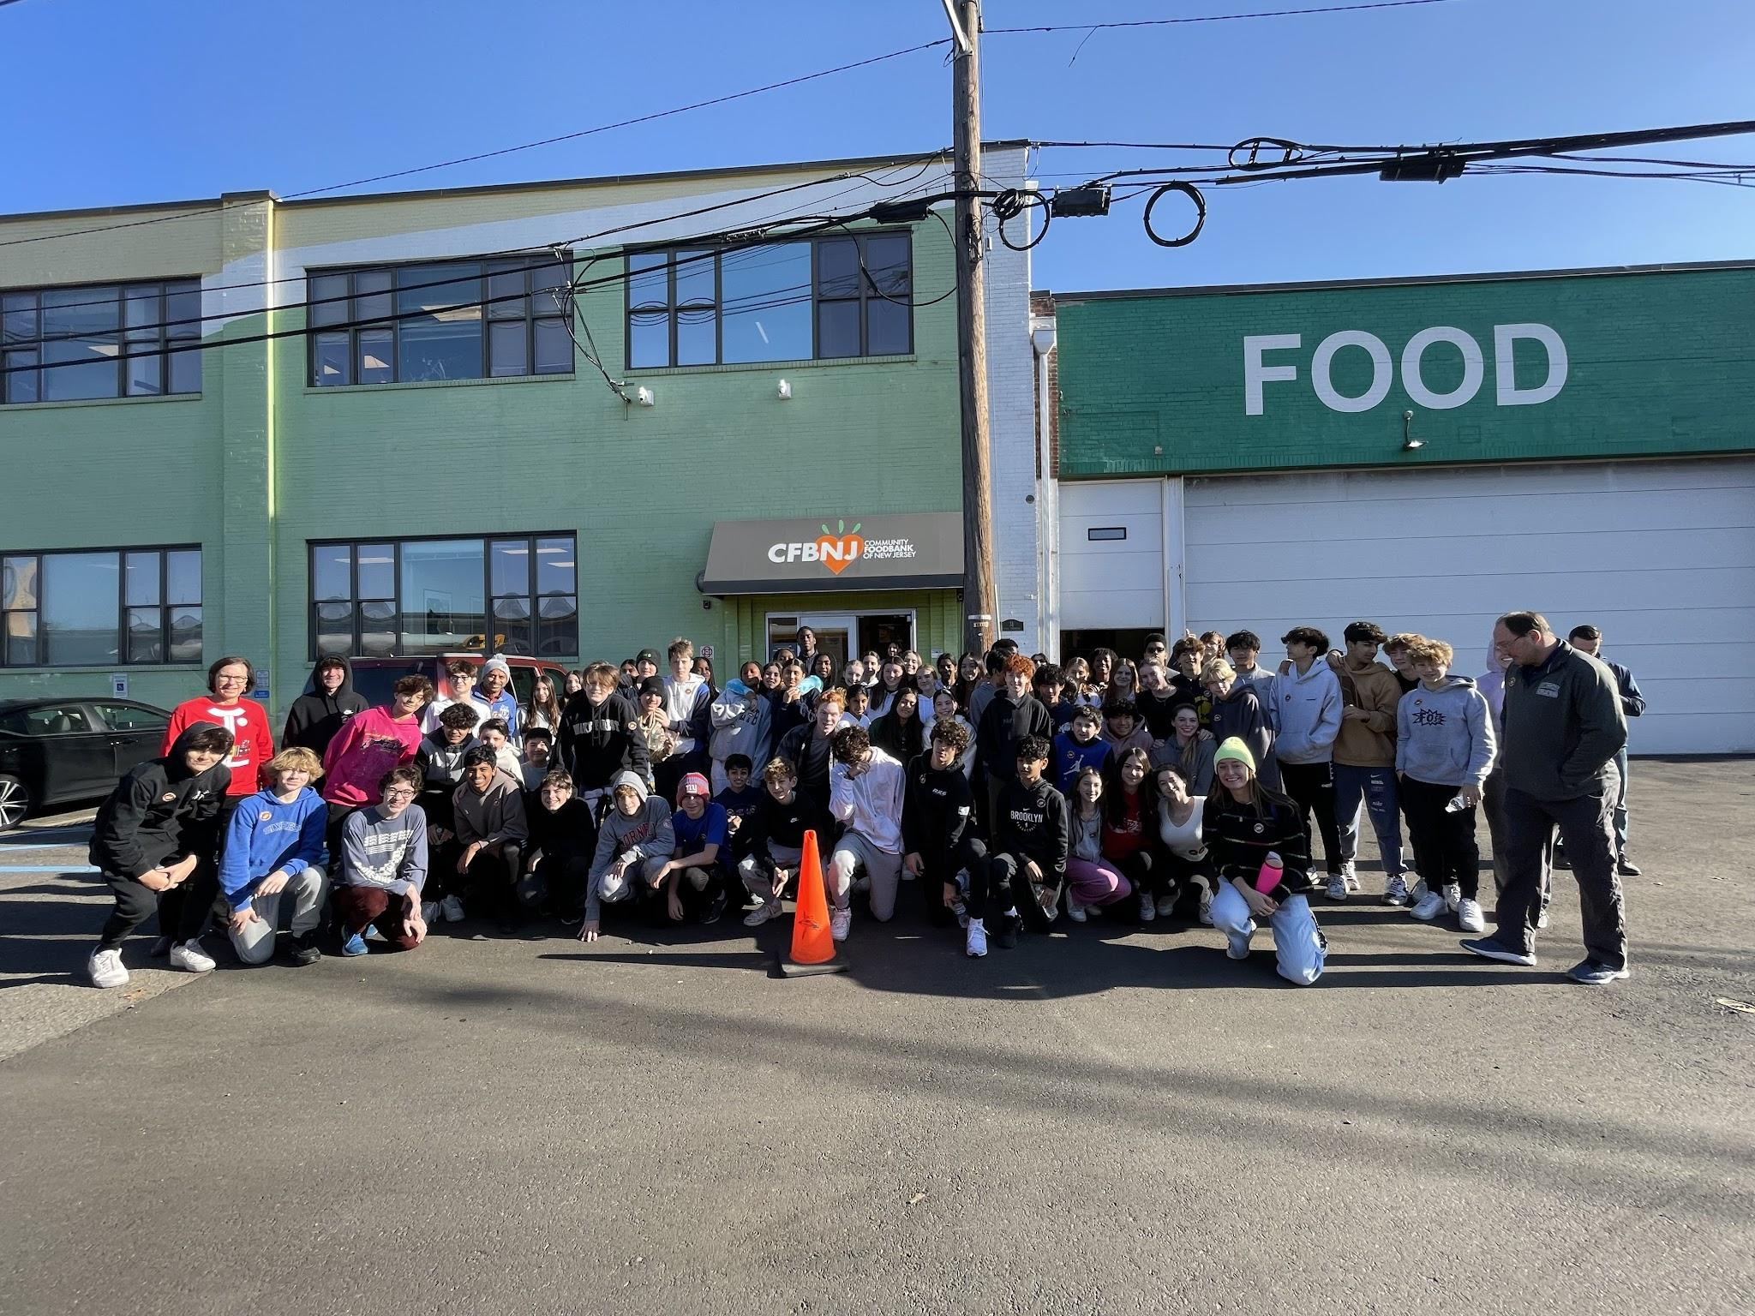
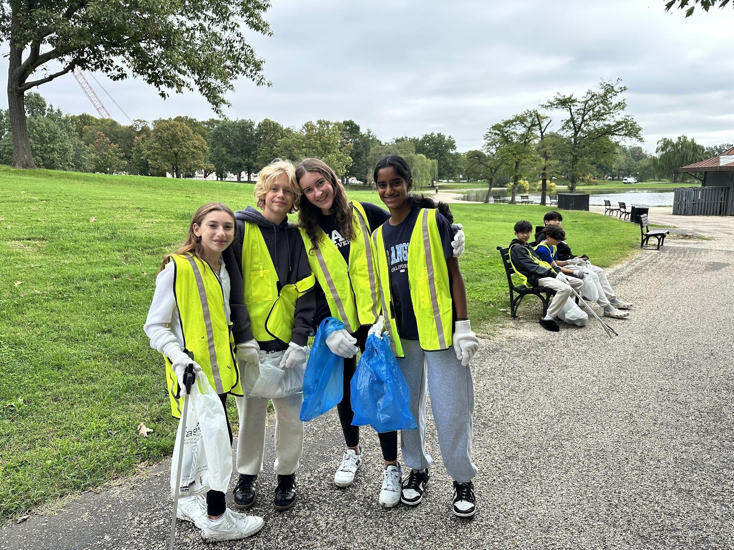
Service trips this year
Three service opportunities this year

Slide 21
Required Summer Reading
Piecing Me Together by Renee Watson
(ISBN: 9781681191058)
Notes:
Also a community of readers book

Slide 22
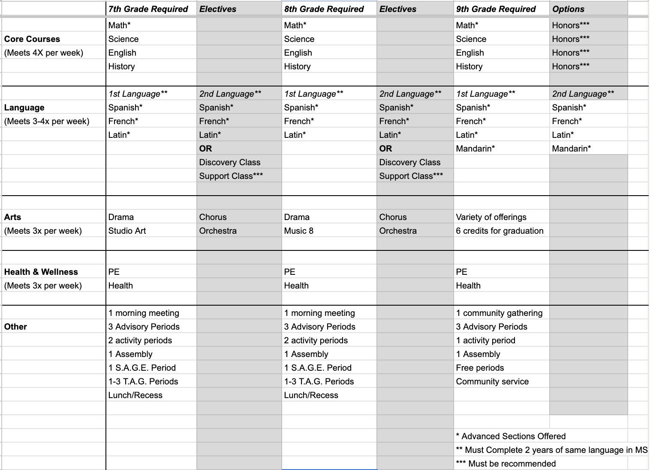
Guage.

Slide 23
Summer Mailing…what to expect
Letter from the principal, Mr. Davis
Information about required forms & important links
2 piece learning platform: iPad and Levenger
Cell phone and backpack policy
Drop off and pick up information
Book list of required texts for purchase (use placement letter for classes)
Overnight information and medical form
SEEK trips information
Music booklet/private music lesson contract
Picture day form
Parent volunteer sign-up
Athletic department Program overview
Health and Wellness Program information
Shopping List of necessary supplies for 8th graders

Slide 24
Important Dates beginning of 2024-2025 school year
July 1: Health forms due
September 3: Classes begin
September 19: Middle School Back to School Night
September 25-27: SEEK Trips
Oct. 3-4: Rosh Hashanah (No school)

Slide 25
Ali Miller
millea@d-e.org
201-227-3236

